Slide 1


Slide 2

Background
EU Funded Project.
Seeks to support the European Union’s Pact on Drug Trafficking.
Identify key source countries for drug reception.
Project commenced January 2015.
3 partner Member States from outset: Romania, Lithuania, Spain.

Slide 3
Key Objectives
1. To evaluate how criminal records across the EU can be utilised to support an EU Pact on international drug trafficking
2. To identify a model that enables analysis of criminal records to continue once the project expires. This model should also be flexible enough to be applicable to analysis of all forms of offending.
3. To identify how existing EU co-operation mechanisms can be enhanced by using criminal records to combat international drug trafficking.

Slide 4
ECRIS Connectivity

Slide 5
ECRIS Volumetrics
MS | 2012 | 2013 | 2014 | 2015 | Total
Germany | 58094 | 127217 | 245831 | 283446 | 714588
Poland | 64352 | 135349 | 146594 | 191597 | 537892
Romania | 36647 | 80187 | 105261 | 334481 | 556576
France | 35151 | 82165 | 104419 | 99280 | 321015
Italy |  | 73249 | 131682 | 147397 | 352328
UK | 27253 | 86354 | 88554 | 163103 | 365264
Spain | 31724 | 55253 | 57155 | 82629 | 226761
Austria | 24365 | 54410 | 61345 | 61449 | 201569
Belgium | 1367 | 44093 | 43945 | 63924 | 153329
Lithuania | 8848 | 28809 | 36869 | 47289 | 121815
Netherlands | 5054 | 20317 | 46788 | 63792 | 135951
Bulgaria | 997 | 16648 | 36441 | 45707 | 99793
Czech Republic | 779 | 11972 | 33050 | 35527 | 81328
Ireland | 120 | 10190 | 24505 | 30312 | 65127
Latvia | 1132 | 9424 | 12671 | 23235 | 46462
Hungary | 230 | 4030 | 13313 | 22621 | 40194
Luxembourg |  | 4080 | 11810 | 14285 | 30175
Croatia |  | 2572 | 11132 | 17841 | 31545
Estonia | 1499 | 3829 | 7044 | 9504 | 21876
Finland | 945 | 2715 | 8671 | 12354 | 24685
Denmark | 666 | 3354 | 6993 | 10411 | 21424
Sweden |  | 624 | 10207 | 17658 | 28489
Slovakia | 1252 | 2767 | 4618 | 20924 | 29561
Cyprus |  | 1043 | 4783 | 6106 | 11932
Greece | 498 | 1992 | 2952 | 7056 | 12498
Slovenia |  |  | 6 | 0 | 6
Malta |  |  |  | 2 | 2
TOTAL | 300973 | 862643 | 1256639 | 1811930 | 4232185

Slide 6
Workstream 1
Research and Analysis of criminal records data to identify international drug trafficking trends.
Workstream 2
Workstream 3
Implement an IT capability to efficiently extract offence and conviction data from ACRO systems.
Host an International closing event to relay the findings of the research to stakeholders.

Slide 7
Year |  | 2015 |  |  |  |  |  |  |  |  |  |  |  | 2016 |  |  |  |  |  |  |  |  |  |  |  | 2017
Month |  | Jan-15 | Feb-15 | Mar-15 | Apr-15 | May-15 | Jun-15 | Jul-15 | Aug-15 | Sep-15 | Oct-15 | Nov-15 | Dec-15 | Jan-16 | Feb-16 | Mar-16 | Apr-16 | May-16 | Jun-16 | Jul-16 | Aug-16 | Sep-16 | Oct-16 | Nov-16 | Dec-16 | Jan-17 | Feb-17 | Mar-17
Month Number |  | 1 | 2 | 3 | 4 | 5 | 6 | 7 | 8 | 9 | 10 | 11 | 12 | 13 | 14 | 15 | 16 | 17 | 18 | 19 | 20 | 21 | 22 | 23 | 24 | 25 | 26
WS0 | Product Initiation |  | End Stage
WS1 | Research |  |  |  |  |  |  |  |  |  | End Stage
WS1 | Analysis |  |  |  |  |  |  |  |  |  |  |  |  |  |  |  |  |  |  |  | End Stage |  |  | End Stage
WS1 | Reporting |  |  |  |  |  |  |  |  |  |  |  |  |  |  |  |  |  |  |  |  |  |  |  | End Stage
WS2 | Requirements |  |  |  |  | End Stage
WS2 | Development |  |  |  |  |  |  |  |  | End Stage
WS2 | Testing |  |  |  |  |  |  |  |  |  | End Stage |  |  |  |  |  |  | End Stage
WS2 | Deployment |  |  |  |  |  |  |  |  |  |  | End Stage |  |  |  |  |  |  | End Stage
WS3 | Research / Requirements |  |  |  |  |  |  |  |  |  |  |  |  |  |  |  | End Stage
WS3 | Procurement |  |  |  |  |  |  |  |  |  |  |  |  |  |  |  |  | End Stage
WS3 | Delegate Engagement |  |  |  |  |  |  |  |  |  |  |  |  |  |  |  |  |  |  |  |  | End Stage
WS3 | Event |  |  |  |  |  |  |  |  |  |  |  |  |  |  |  |  |  |  |  |  |  |  |  |  | End Stage
WS3 | Reporting |  |  |  |  |  |  |  |  |  |  |  |  |  |  |  |  |  |  |  |  |  |  |  |  |  | End Stage
Project Closure |  |  |  |  |  |  |  |  |  |  |  |  |  |  |  |  |  |  |  |  |  |  |  |  |  |  |  | Project End
Meetings |  | Jan-15 | Feb-15 | Mar-15 | Apr-15 | May-15 | Jun-15 | Jul-15 | Aug-15 | Sep-15 | Oct-15 | Nov-15 | Dec-15 | Jan-16 | Feb-16 | Mar-16 | Apr-16 | May-16 | Jun-16 | Jul-16 | Aug-16 | Sep-16 | Oct-16 | Nov-16 | Dec-16 | Jan-17 | Feb-17 | Mar-17
Kick Off Meeting |  |  | KO1
PNC Meeting |  |  |  | PNC1
Finance Meetings |  |  |  | F1 | F2 | F3 | F4 | F5 | F6 | F7 | F8 | F9 | F10 | F11 | F12 | F13 | F14 | F15 | F16 | F17 | F18 | F19 | F20 | F21 | F22
Team Meetings |  |  | TM1 / TM2 | TM3 / TM4 | TM5 / TM6 | TM7 / TM8 | TM9 / TM10 | TM11 / TM12 | TM13 / TM14 | TM15 / TM16 | TM17 / TM18 | TM19 / TM20 | TM21 / TM22 | TM23 / TM24 | TM25 / TM26 | TM27 / TM28 | TM29 / TM30 | TM31 / TM32 | TM33 / TM34 | TM35 / TM36 | TM37 / TM38 | TM39 / TM40 | TM41 / TM42 | TM43 / TM44 | TM45 / TM46 | TM47 / TM48
IT Meeting |  |  |  |  | IT1
Project Board Meetings |  |  |  | PB1 |  |  | PB2 |  |  |  |  |  |  | PB3 |  |  | PB4 |  |  |  | PB5 |  |  |  | PB6
Conference |  |  |  |  |  |  |  |  |  |  |  |  |  |  |  |  |  |  |  |  |  |  |  |  |  | 30-31
Communication Plan |  | Jan-15 | Feb-15 | Mar-15 | Apr-15 | May-15 | Jun-15 | Jul-15 | Aug-15 | Sep-15 | Oct-15 | Nov-15 | Dec-15 | Jan-16 | Feb-16 | Mar-16 | Apr-16 | May-16 | Jun-16 | Jul-16 | Aug-16 | Sep-16 | Oct-16 | Nov-16 | Dec-16 | Jan-17 | Feb-17 | Mar-17
Member States |  |  |  |  |  |  | CIRCABC |  |  |  |  |  | CIRCABC |  |  |  |  |  | CIRCABC |  |  |  |  |  | CIRCABC | CIRCABC
Project Board |  |  | End of Stage Report |  | Highlight Report 1 | End of Stage Report |  | Highlight Report 2 |  | End of Stage Report | 2 x End of Stage Report | Highlight Report 3 & End of Stage Report |  |  |  | Highlight Report 4 | End of Stage Report | End of Stage Report x 2 | End of Stage Report |  | End of Stage Report | End of Stage Report |  | Highlight Report 5 & End of Stage Report | End of Stage Report | End of Stage Report | End of Stage Report
Home Office |  |  |  |  |  |  |  |  |  |  | Quaterly Report (Deadline: 02/10/2015) |  |  | Quaterly Report (Deadline: 04/01/2016) |  |  | Quaterly Report (Deadline: 04/04/2016)
EU Commission
Country Visits |  | Jan-15 | Feb-15 | Mar-15 | Apr-15 | May-15 | Jun-15 | Jul-15 | Aug-15 | Sep-15 | Oct-15 | Nov-15 | Dec-15 | Jan-16 | Feb-16 | Mar-16 | Apr-16 | May-16 | Jun-16 | Jul-16 | Aug-16 | Sep-16 | Oct-16 | Nov-16 | Dec-16 | Jan-17 | Feb-17 | Mar-17
Romania |  |  |  | 31-01 |  |  |  |  |  |  |  | 17-18
Lithuania |  |  |  | 23-24 |  |  |  |  |  |  |  | 10-11 |  |  |  |  |  |  |  |  |  | 12-13'
Spain |  |  |  |  | 21-22 |  |  |  |  |  |  | 02-03 |  |  |  |  |  |  |  |  |  | 22-23
Europol - The Netherlands |  |  |  |  |  |  | 29-30 |  |  |  |  |  |  |  |  |  |  |  |  |  |  |  |  |  |  | ?
Interpol - Lyon |  |  |  |  |  |  |  |  |  |  |  |  |  |  |  |  |  |  |  |  |  |  |  |  |  | ?
ERIC Conference - London |  |  |  |  |  |  |  |  |  | 08
Belgium |  |  |  |  |  |  |  |  |  | 23 |  |  |  |  |  |  |  |  |  |  |  |  |  | 7
Germany |  |  |  |  |  |  |  |  |  |  | 13-14 |  |  |  |  |  |  |  |  |  |  |  | 18-19
Italy |  |  |  |  |  |  |  |  |  |  | 20-21
EMCDDA - Portugal |  |  |  |  |  |  |  |  |  |  | 27-28 |  |  |  |  |  |  |  |  |  |  |  |  |  |  | 10-11
Croatia |  |  |  |  |  |  |  |  |  |  |  |  |  |  |  |  |  |  |  |  |  |  |  | 16-17
Hungary
Quality Assurance |  | Jan-15 | Feb-15 | Mar-15 | Apr-15 | May-15 | Jun-15 | Jul-15 | Aug-15 | Sep-15 | Oct-15 | Nov-15 | Dec-15 | Jan-16 | Feb-16 | Mar-16 | Apr-16 | May-16 | Jun-16 | Jul-16 | Aug-16 | Sep-16 | Oct-16 | Nov-16 | Dec-16 | Jan-17 | Feb-17 | Mar-17
Email Folders |  |  |  |  |  | QA |  |  |  |  |  |  | QA |  |  |  |  | QA |  |  |  |  |  |  | QA
Config Item Review |  |  |  |  |  | QA |  |  |  |  |  |  | QA |  |  |  |  | QA |  |  |  |  |  |  | QA
Software Folders |  |  |  |  |  | QA |  |  |  |  |  |  | QA |  |  |  |  | QA |  |  |  |  |  |  | QA

Slide 8
Project Plan
WS1
Research
Analysis
WS2
Requirements
Development
WS3
Reporting
Testing
Deployment
Research / Requirements
Procurement
Delegate Engagement
Event
Reporting

Slide 9

EPDT Conference
31st January 2017
Park Hotel, London
Use of ECRIS – Claire Wills

Slide 10



Notes:
The Council Framework Decision 2009/315/JHA legislated for the exchange of information, extracted from criminal records, between Member States. ECRIS- the European Criminal Record Information System – started as you may well know on 26th April 2012. It was legislated under Council Decision 2009/316/JHA. It started with only a few Member States exchanging through the system. Other Member States continued with the NJR (Network of Judicial Registers) system which was the forerunner of ECRIS for a few months, other Member States continued using email communication until they were ready to use the electronic exchange. Currently all but two Member State are connected to at least one other Member State via ECRIS. The connectivity is around 72% of the possible total currently as some Member States have connected to some but not all other available Member States.
The aim of the system was to enable member States to share conviction information using common codes so that the information would be easily understood in every Member State. Thus all member States mapped their offences to 188 Common Offence categories, for example Intentional Killing, Manufacture or production of narcotic drugs not exclusively for personal consumption; and their sanctions to 70 Common Sanction categories, for example Imprisonment, Fine, Confiscation. This means that there is common understanding of the types of offences in a conviction. Other fields within the system also use codes to facilitate the exchange. These include codes for Countries and Nationality, for Gender for example.
All Member States use what is known as the ECRIS RI (RI standing for the Implementation of the References in 2009/316/JHA). One Member State has built their own RI whilst other member States have used the version provided by the European Commission. The use of a common standard has facilitated understanding between Member States.
Many people will use the terms ECRIS and ECRIS RI interchangeably – I will use ECRIS from now on although I may be talking about the exchange or the software involved in the exchange.

Slide 11


Out
UK
Other MS
In
Message Types
REQ RDL RRS (RAI, RAR, FEM, CAN)
Message Types
NOT NRS (RAI, RAR, FEM, CAN)
Notes:
There are 2 main events in ECRIS Requests and Notifications. We also refer to 2 types of each In and Out.
A Request Out is a request for criminal conviction history from the UK to another Member State
A Request In is a request for criminal conviction history from another Member State to the UK
Within the ECRIS system and the statistics a Request will have at least 3 messages, but that can be many more if Additional information is requested by the receiving Member State.
A Notification Out is the sending of information on a conviction from the UK to the Member State of nationality.
A Notification In is the sending of information on a conviction from another Member State to the UK
Within the ECRIS system and the statistics a Notification will have at least 2 messages, but that can be many more if Additional information is requested by the receiving Member State.
The total number of messages exchanged through ECRIS will therefore be a multiple of the number of requests and Notifications sent through the system.

Slide 12

ECRIS Statistics
  Purpose
  Yearly
  Monthly
  Technical
  Functional
  Business
Notes:
There is a large amount of data available through ECRIS based on the number and type of messages exchanged.
The purpose of the Statistics collected through ECRIS is to provide accurate objective and factual information.
The purpose of collecting non–personal statistical data is not that of producing general statistics on the conviction information handled in the Member States, such as offences and sanctions, but only to collect the most significant statistical parameters so as to allow the pertinent assessment of ECRIS’ efficiency and effectiveness.
The purpose of the statistics as described in this document is not to allow PROFILING analyses for each Member State, such as for example showing how many times a certain type of offence has been perpetrated by persons of a given nationality, or calculating the average levels of the sanctions pronounced by courts of specific Member States.
(from ECRIS Technical Specifications Logging, Monitoring and Statistics Analysis)
The information collected by ECRIS is data on for example how many responses to requests included at least one conviction.
What is not stored is details on the convictions exchanged. This information can only be obtained through each Member State.
There are 2 sets of statistics which are available currently through ECRIS these are monthly and yearly and cover different elements.
The yearly statistics cover elements such as how many connections have been made between the 28 Member States, the number of different types of messages and for what purpose requests for a criminal record were sent. They also provide a comparison year on year on these elements.
The monthly statistics, whilst also giving the same data for the month in question will also give some more detailed information this is based on 232 ‘indicators’. These Statistical Indicators cover Technical, Functional and Business statistics.
The Technical are those related to the performance of the system.
The Functional are those related to the use of the functionality of the system
The Business are those related to the different types of message and to the purpose of the requests for criminal conviction history. There at least 40 indicators of these. For example there are a specific set of statistics around directive 93 – that to do with Sexual Exploitation of children – including how many requests under directive 93 have not had a response.
There is also an indicator of how many requests have been sent for Third Country Nationals – a current concern for ECRIS where work is being done to try and establish a centralised database which all Member States will be able to search to establish whether a subject has been convicted in an EU Member State.
The EU Commission has noted that in addition to the statistics mentioned, it may prove interesting for the Member States and the central entity to consider collecting statistical data also for purposes of analysis of the business processes not supported directly by the ECRIS software, but which influence directly the exchange of criminal records information such as: translation, parts of the matching/identification process, evaluation of the specifics of the identified person, evaluation of the legal terms of the request/of the notified convictions, etc. However that work would be outside the scope of the ECRIS exchange as currently implemented.

Slide 13
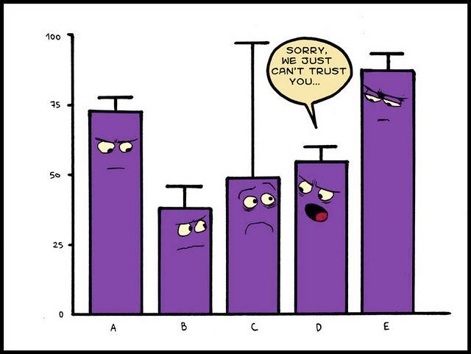
Issues with data
Notes:
Unfortunately due to various connectivity issues the picture is not complete across the EU. Whilst the ECRIS Support Team can assist in resolving technical issues, there is no incentives to Member States to implement any solutions provided nor any penalties for not connecting via ECRIS. Whilst understanding that such penalties would not be popular or may not indeed be possible it does seem that ECRIS compliance is without teeth and relies on peer pressure from Member States to encourage each to connect to each other.

Slide 14
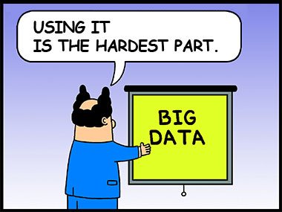
Use of ECRIS Statistics
Notes:
The use of the data provided by ECRIS is varied.
As time has passed and there is a store of data for a period of years, the ability to analyse the data provided by the European Commission and a Member States own data would help each member state predict peaks and troughs in work enabling them to manage staffing more effectively.
Some Member States do this more effectively that others – it will depend on their staffing and the desire to gain such information. As is often said there is no use in producing statistics for statistics sake – there has to be a need for them and a wish to act upon the result.
Member States could also benefit from some Intelligence research around the type of criminality encountered in the country where the offending is taking place and comparing this to the types of criminality held by the country of nationality. It would also be possible to look at travelling offenders and their criminality across several EU member States. This would have implications for law enforcement in understanding the offending behaviours and would assist in Public Protection from a National perspective.

Slide 15

Analysis of data
Notes:
Analysing data nationally and across the EU presents challenges because of each Member States retention legislation. The only way to truly obtain a picture across the EU for travelling offenders would be for all countries to agree to share specific data.
The EPDT has shown ACRO some of the possibilities of analysis of data help both within the UK and available through ECRIS. Further analysis will need to be undertaken to fully realise the potential of such data.
The project obtained the use of PowerBI as an add-on for Excel for data analysis. Other members of staff have gained experience in using this and further training is being considered. I myself have used it successfully to obtain information requests under the UK’s Freedom of Information legislation. The information requested was held in different tables and sources of data within the database system used by ACRO. There was a considerable saving of time and money as I was able to pull information from the system and then use PowerBI to analyse it rather than having to pay for our system supplies to provide reports.

Slide 16

Claire.Wills@acro.pnn.police.uk

Slide 17
Workstream 1 - Research and Analysis of criminal records data to identify international drug trafficking trends.
Questionnaire
We have received responses from all 28 EU Member States
Phase 1
15 responses received (plus UK data – 16)
Phase 2
8 responses received (plus UK data – 9)
Notes:
ECRIS Priority was to exchange data – There was no intention to analyse ECRIS data at the inception of ECRIS.

Slide 18
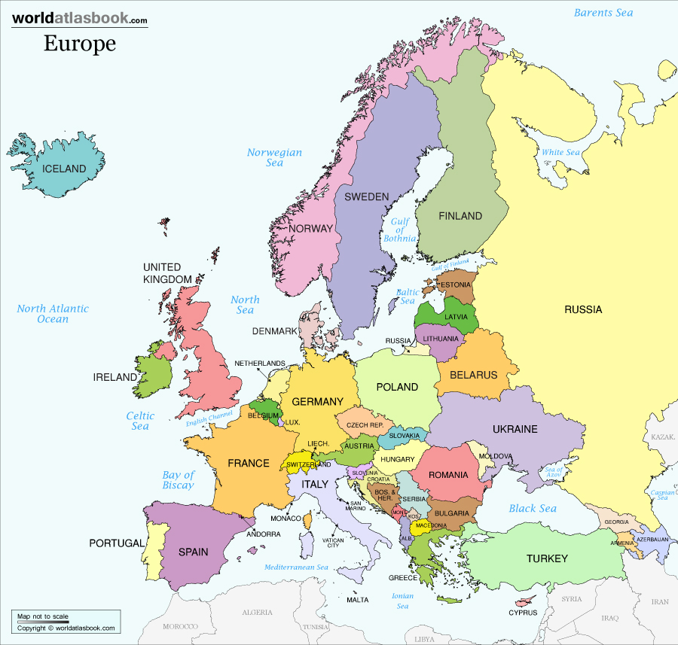



Slide 19








Workstream 1 – ECRIS Data
Data requirements spreadsheet shared with all countries that have provided Phase 1 volumetric data.
Quality Assurance Framework.
Worked closely with our 3 partner countries.
We have also received data from:

Slide 20
Workstream 1 – National Register Data
Date Parameters
Offence Codes

Slide 21
UK National Criminal Register (PNC)
68,460,000
Rows of data received from PNC
10,521,792
194,421
111,575
Offences sent from PNC Services
40 PNC ‘umbrella’ codes (2011 – 2014)
Specified Heroin and Cocaine offences

Slide 22
Work Stream 2 - Implement an IT capability to efficiently extract offence and conviction data from ACRO systems.
Potential to utilise Microsoft Excel 2013 products:
Benefits:
  Compatible with most data systems across the EU
  Cost effective
  Allows quick time analysis of data
  Enables project team to map criminal record information

Slide 23
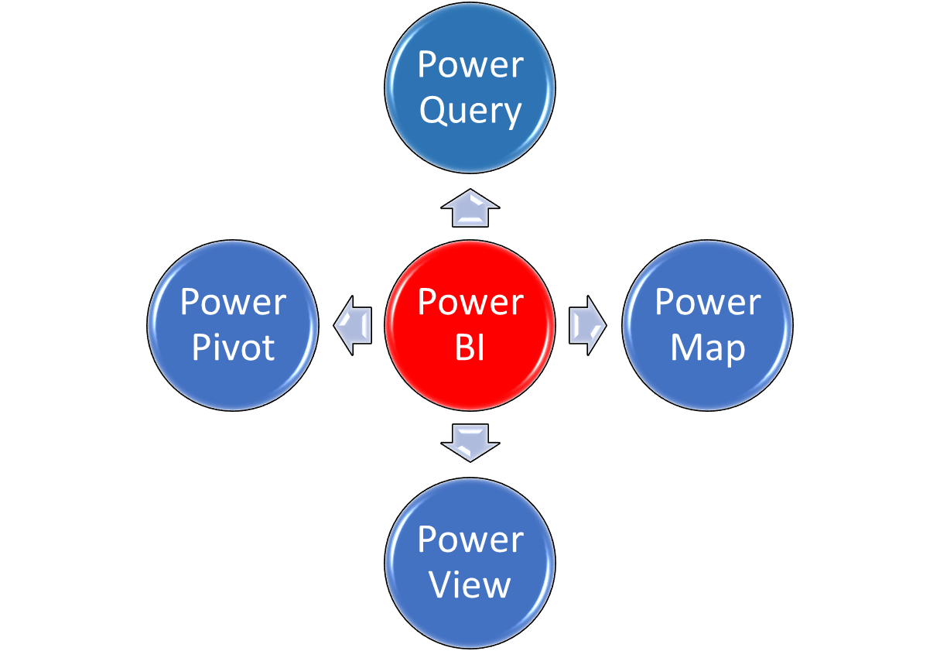
Work Stream 2
Power Business Intelligence (BI)

Slide 24
Analytical Highlights

Slide 25
Influencing Factors
Legislative differences across EU
ECRIS Connectivity
Specific Drug Type Identification
Retention of ECRIS Data
Recording of Offence Location

Slide 26
Summary – Why Analyse ECRIS
EU Added Value
Maximise value derived from EU criminal record exchange
Further support the understanding of international drug trafficking across the EU
ACRO Benefits
Promote the value of having UKCA-ECR managed by the police service
UK Benefits
Identify a model that can be used by EU Member States to identify trends in criminal records data
Enhance synergy between existing EU cooperation instruments
Create a sustainable solution to identify and analyse intelligence from ACRO systems
Provide professional development opportunities for ACRO staff
Promote the work of ACRO and the value of criminal record and intelligence analysis on an international scale
Maximise the value to the UK of intelligence derived from criminal records data (Human Trafficking)
Promote the reputation of the UK within the EU Law Enforcement community for innovation
Provide a report based on 4 years accumulated data (2011 to 2014) of drug trafficking patterns and trends within the EU and the impact to the UK.

Slide 27
Monitoring drug supply in Europe: making the most of existing data
Nicola Singleton, Teodora Groshkova, EMCDDA
London, 31st January 2017
European Pact on Drug Trafficking Conference

Slide 28
Outline
Who we are and what we do
General supply monitoring issues
Drug supply indicators
3.1. Improvement of established measures
3.2. New sources and tools
Putting the data together: what can it tell us about supply?
Summary & discussion

Slide 29

The EMCDDA
A decentralised EU agency (100 staff)
Formally established in 1993
Based in Lisbon, Portugal (operating since 1995)
The hub of drug-related information in the EU

Slide 30
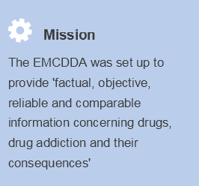



EMCDDA’s mandate
Why do we do it?
Inform decision-making on drugs
Generate a high-quality European evidence base
Understand what responses work
Provide early-warning on new threats and developments

Slide 31
Drugs and supply monitoring - an EU priority…
the EU Drugs Strategy (2013-2020) has a supply reduction pillar and sets a priority to “work towards more effective policies in the field of drug supply reduction, by reinforcing policy evaluation and analysis to improve the understanding of drug-markets, drug-related crimes and the effectiveness of drug-related law enforcement responses”,
the EU Action Plan on Drugs (2013-2016) calls on the parties concerned "to develop and progressively implement key indicators on drug supply by standardising, improving and streamlining data collection in this field, building on currently available data", (Action 16)
The Council of the EU conclusion (15 November 2013) stresses that accurate, reliable, comparable and high-quality data on drug supply would help assess the drug situation, the dynamics of the illicit drug market, the burden of drug-related crime and the effectiveness of supply-oriented policies.

Slide 32
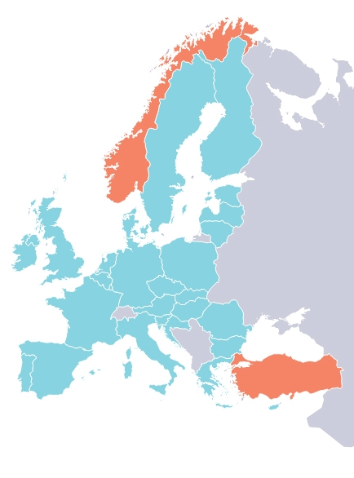
Networks of partners & routine monitoring
28 EU MS, Norway, Turkey
Annual reporting exercise
Standardized reporting tools improved incrementally over last 20 years
New supply indicators
Additional partners
    Reference group on drug supply indicators
    Europol
    Eurojust
    EC (Joint Research Centre, Eurostat, Taxud)

Slide 33
In practical terms this means:
    Addressing both security & health issues
      Multidisciplinary & holistic analysis
    Processing and analysing large volumes of data
    Developing standards and common approaches
    Focal points & expert networks allow an ongoing conversation with member states

Slide 34
Monitoring drug supply: general issues

Slide 35
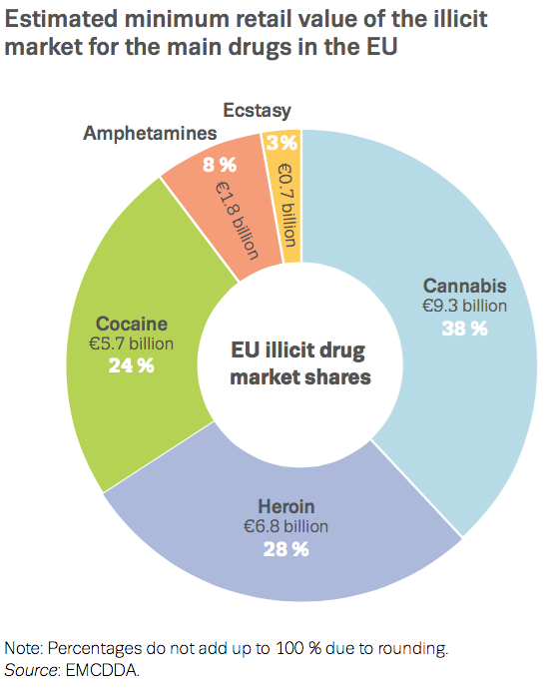
The financial impact of drug markets
€ 24
billion

Slide 36
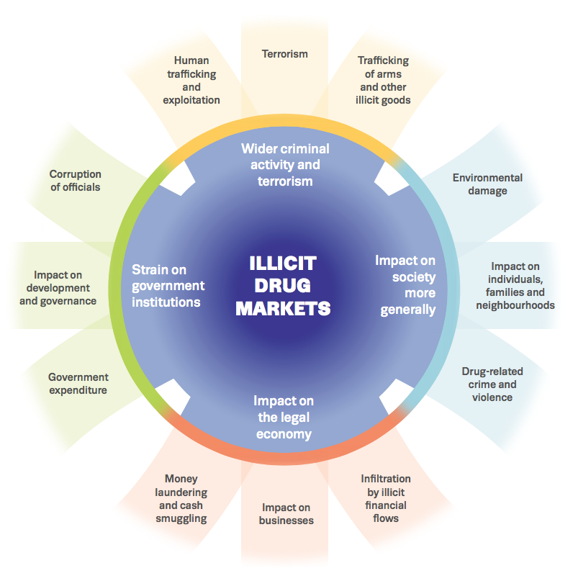
The complex ramifications of the drug market

Slide 37
What are the uses of drug supply-related data
Three main uses:
Inform the formulation, planning and implementation of strategies to disrupt and prevent drug production and trafficking and, by tracking trends, help ensure they remain on target.
Foster operational cooperation, inform the policy dialogue and provide a common basis for mutual understanding and discussion.
Support the quantification and modelling necessary for measuring impact and thus facilitate the debate on the extent to which measures can be shown to work.

Slide 38
Key challenges for measurement
‘Hidden’ phenomenon: difficult to monitor
Mainly data from LE sources: ‘consensual crime’ = ‘dark figure’
Huge range & variety of activities
Data sensitivity and confidentiality - operational factors influence what is possible to collect and data available
Wide range of agencies involved - data from LEAs and CJS sometimes ‘trapped within agencies’
Influence of operational priorities on what is possible to collect and data available
Issues of data comparability: impact of national legislation, CJ practices, political priorities
38

Slide 39
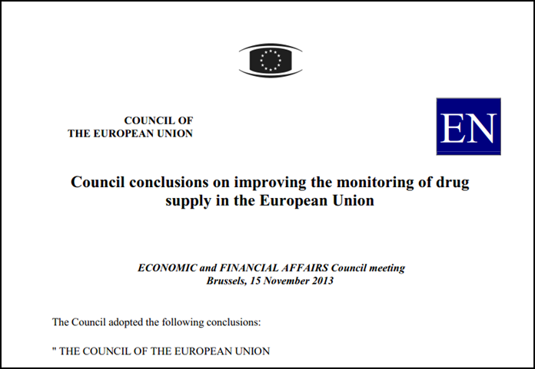
Driving themes for supply indicator development
A dynamic and systematic approach in line with Council Conclusions (2013)
  Focus on a minimum core data set for routine reporting to form a top-level European analysis
  Data quality needs to improve incrementally over time
  The system should be operationally coherent with, and add value to, national level activities (or it won’t work)
  Identify opportunities presented by operational data collection for enhancing our understanding of drug supply patterns and trends

Slide 40
Three kinds of information we are interested in…
Existing information sets routinely collected but not always complete or of high quality
  Tasks developmental and relatively straight forward
  Improving comparability, availability and timeliness
  Priorities should be based on cost to benefits
  Analytical framework at EU level weak
  Data not currently routinely collected by all countries but has potential for routine collection at EU level
  More demanding
  Greater resource implications and requires a longer term vision
  Feasibility questions
  New opportunities & challenges
  Data essential for analysis but not suitable for routine reporting
  Mechanisms for incorporating information on an ad-hoc basis
  Contextual information and research findings
  Operational intelligence expertise

Slide 41
Supply-side monitoring system: EMCDDA framework
CORE DATA
NON-ROUTINE DATA
Drug seizures
Open source information
Drug law offences
    Surface web
    Deepweb — darknet markets
    Retail
    Middle
    Wholesale
    Possession/use
    Supply
    Production
Expert groups
    Europol drugs & NPS experts
    EMPACT: cocaine | heroin | synthetic drugs & NPS
    European Network of Forensic Science Institutions
    Reference Group on drug supply indicators
    Reitox National Focal Points
      EWS correspondents
Prices
Purity
MARKETS,
CRIME,
SUPPLY
REDUCTION
Purity-adjusted prices
Retail — market size estimate
Wastewater analysis
Perceived availability
Individual subject experts
    (in population surveys)
    Retail
Key periodical reports
Production
    World Drug Report (UNODC)
    Crop monitoring reports (UNODC)
    Precursors Report (INCB)
    SOCTA (Europol)
    Cannabis
    Synthetic drugs
    Cocaine extraction
QUANTITATIVE
Workbooks
Ad hoc research
QUALITATIVE
    Markets
    Crime
    Supply reduction
    Web surveys
    Studies: fieldwork | contracts
    Published literature

Slide 42
Drug supply indicators

Slide 43
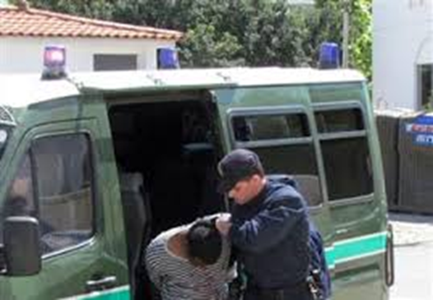
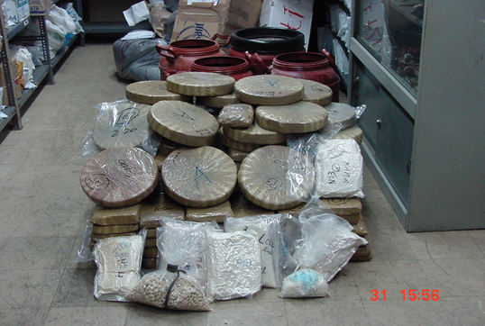


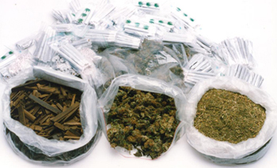
Routine data (+15 years of monitoring)
Drug law offences
Seizures
Prices
Composition of tablets
Potency/Purity

Slide 44
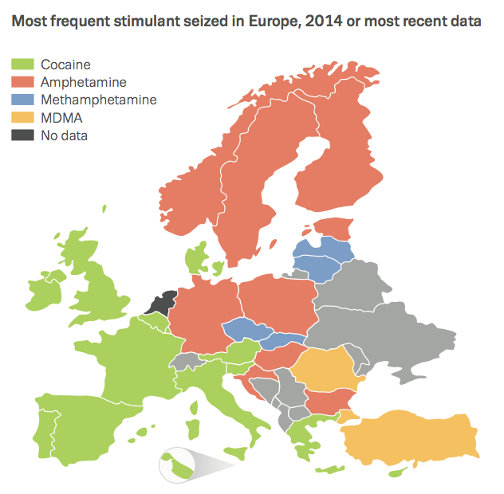
Europe’s stimulant market: geographic divide

Slide 45
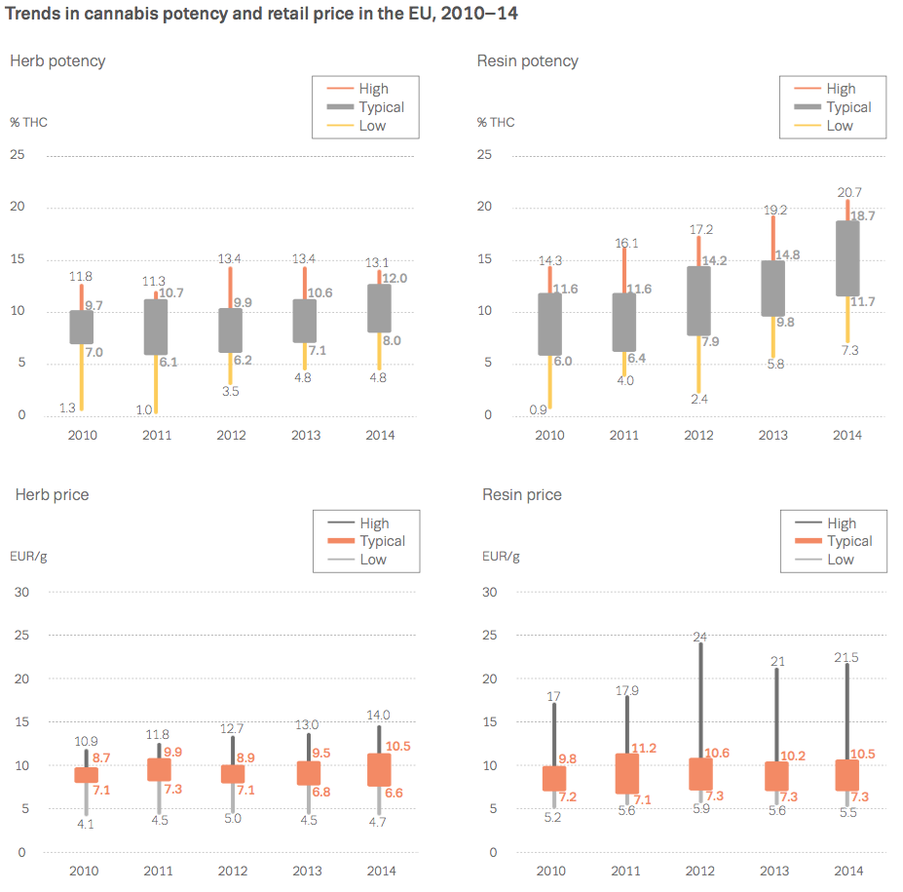
Trends in price and potency

Slide 46
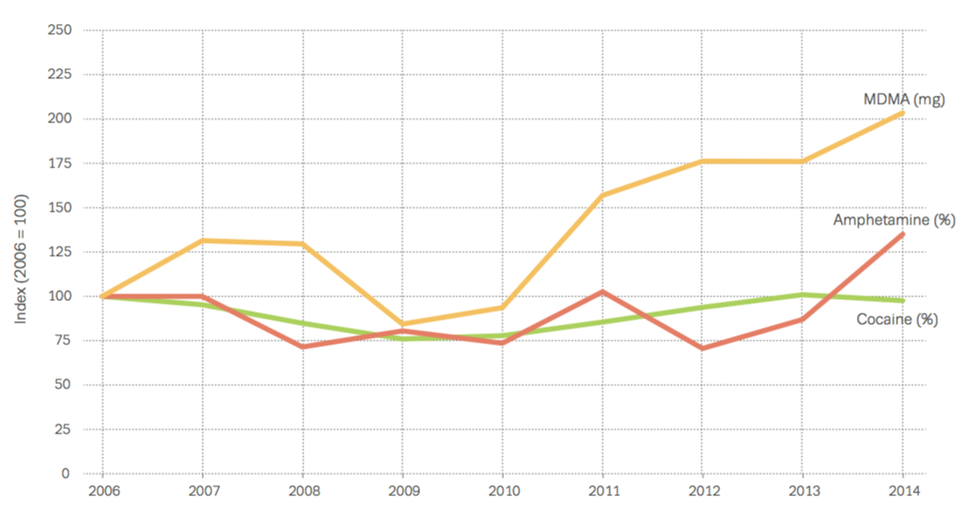
Trends in stimulants purity
Notes:
Finally looking into purity…
Indexed trends point clearly to increases in MDMA-content since 2010.
The availability of high MDMA-content products has prompted joint alerts from Europol and the EMCDDA in 2014.
The purity of cocaine has now levelled off.
For amphetamines, the average reported purity is higher for methamphetamine than for amphetamine samples. Although indexed trends suggest that amphetamine purity has increased in the latest data, the average purity of this drug continues to be relatively low.

Slide 47
Areas for improvement
Expanded scope for reporting
Reporting by market level
Information on trafficking routes
Streamlining and co-ordinating

Slide 48
Drug Law Offences
  Definition: Acts committed in violation of drug, and other drug-related, legislation involving controlled drugs, new psychoactive substances, precursors, or controlled medicinal products diverted to or produced for the illicit market.
  To be counted: a criminal or non-criminal report will have been initiated by law enforcement or other agency, regardless of charges or prosecution.
  Main sub-divisions:
  Type of offence: Use/possession; Supply; Both
  Type of substance: Main list of controlled drugs; NPS; Medicinal products; other significant substances; Unknown; Precursors
  Offences &/or offenders
  Type of supply offence

Slide 49
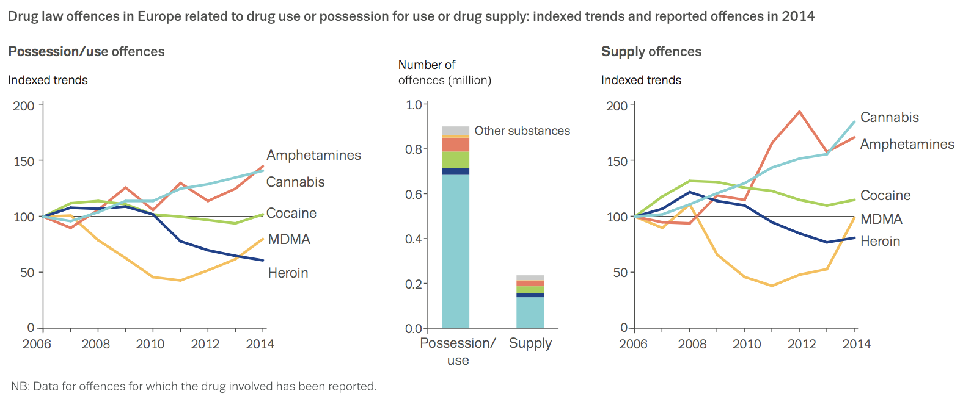
    1.6 million drug law offences
Overall ~75% use/possession
Range: 2% RO, 37% HU, 38% CZ
to 93% AT; 94% LT, 95% ES
Cannabis offences dominate
Three quarters of possession offences

Slide 50
DLO: Interpretation issues
    Impact of different legal frameworks
    Very driven by law enforcement practice & priorities
    Variability with respect to point of recording/ data capture
    Differentiation by drug not always possible
    Drug-specific influences
    Separation of possession & trafficking variable
    Offence vs offender

Slide 51
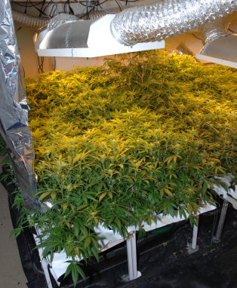
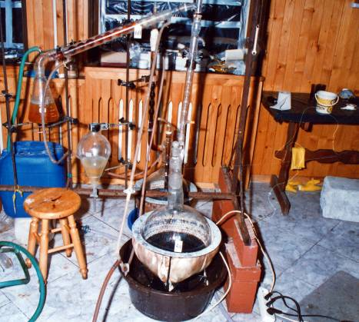




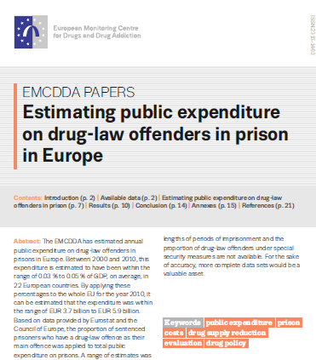
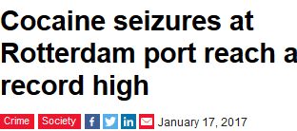
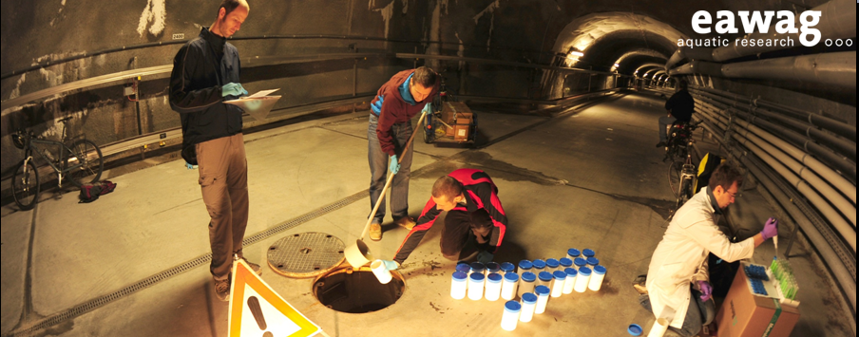
Other data and sources
Darknet monitoring
Production facilities (labs)
Drug related violence (homicides)
Cultivation sites
Wastewater
Open source information
Resources

Slide 52
Putting the data together: what can it tell us about supply?

Slide 53
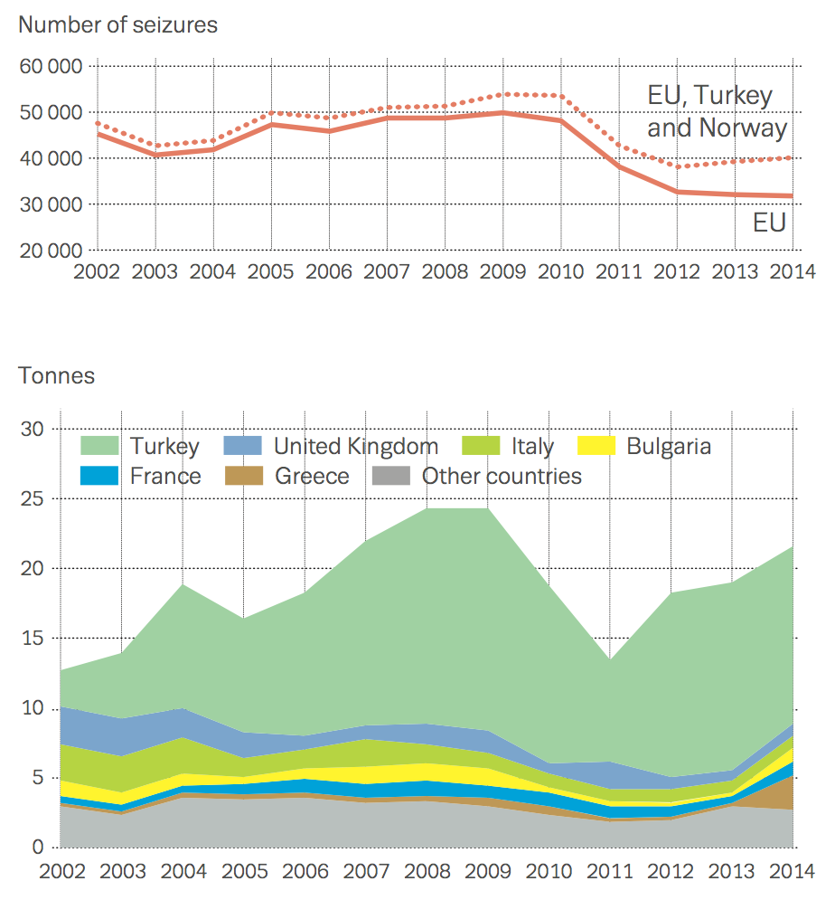
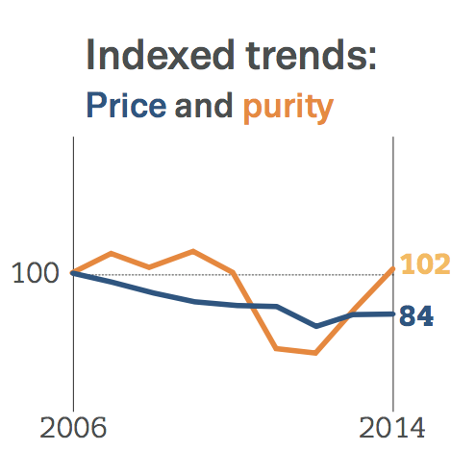
Heroin: recent market changes?
    Number of seizures stable
    …but recent increase in quantities seized
    Rebound of heroin purity

Slide 54
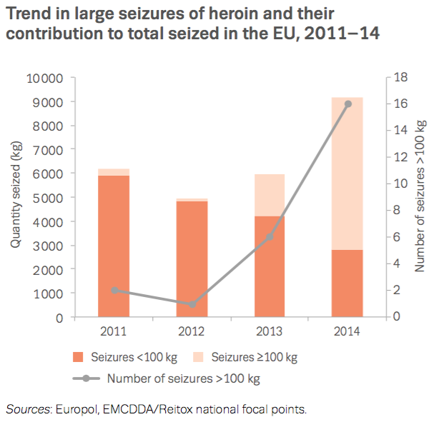
Heroin: increasing large seizures

Slide 55
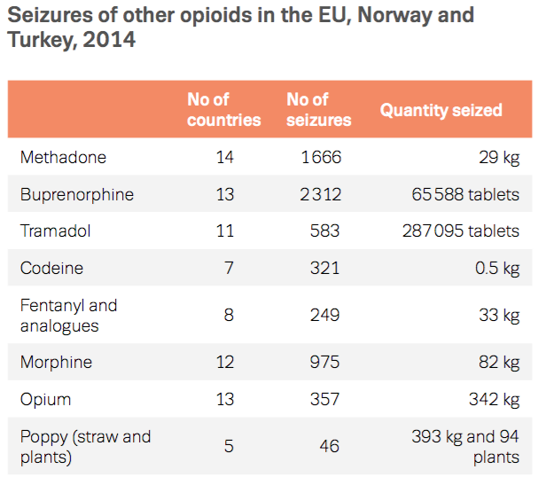
European market for opioids: not just heroin and home-made opioids

Slide 56
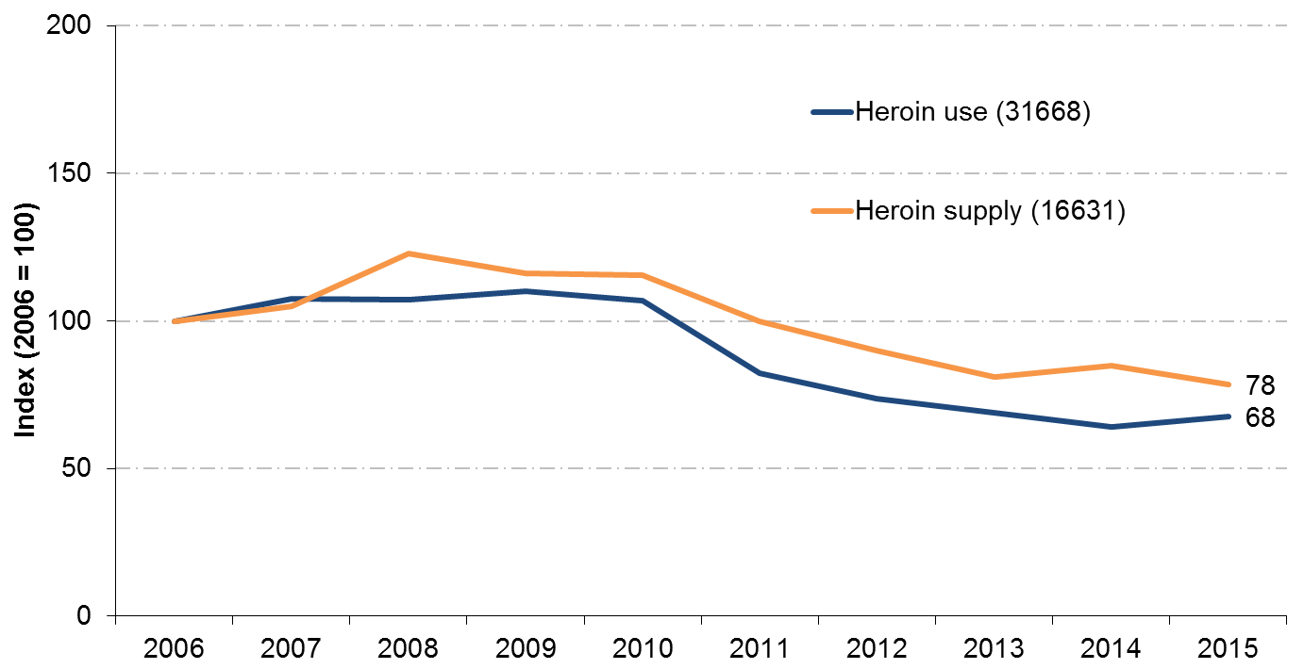
Heroin related offences

Slide 57
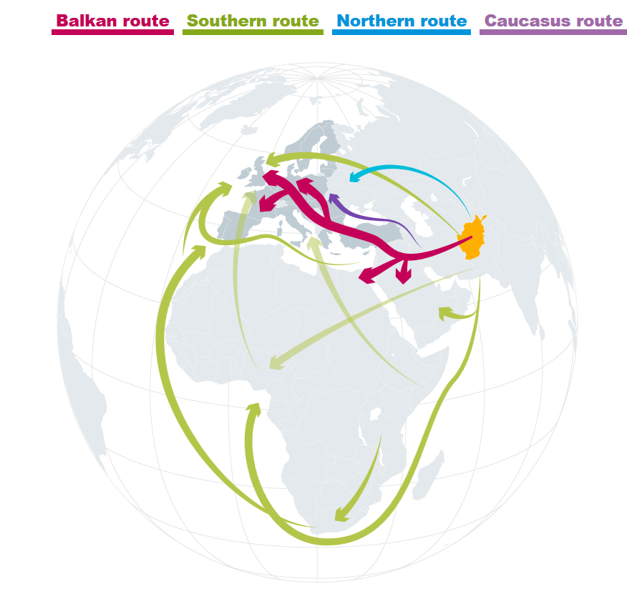
Heroin main trafficking routes into Europe

Slide 58
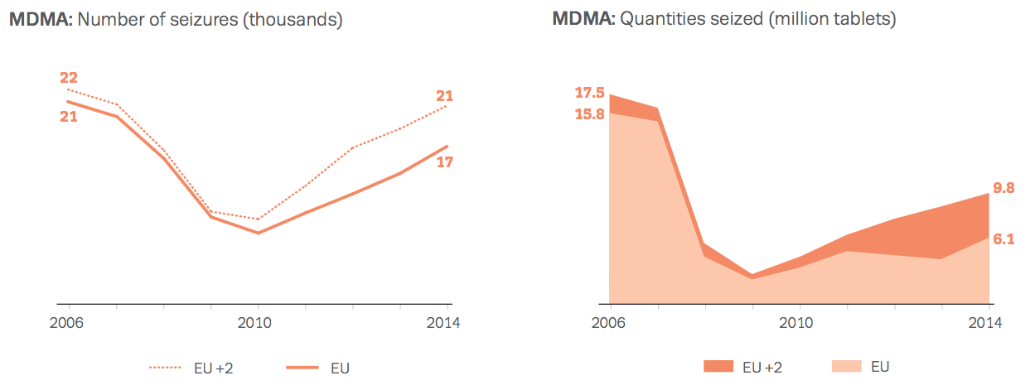
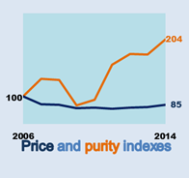
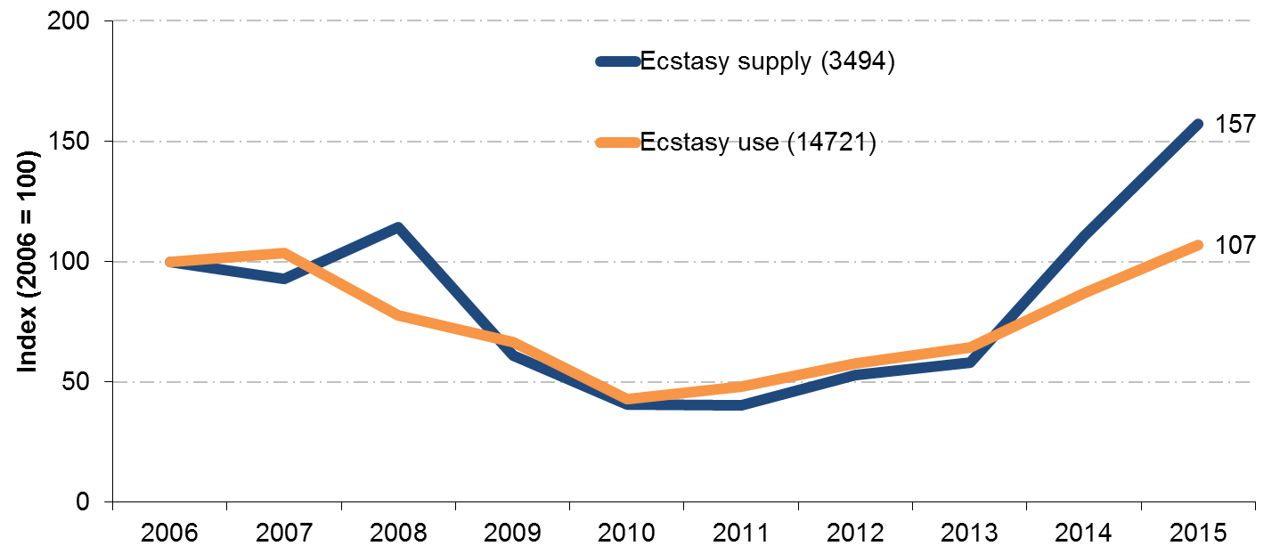
Another example: MDMA

Slide 59

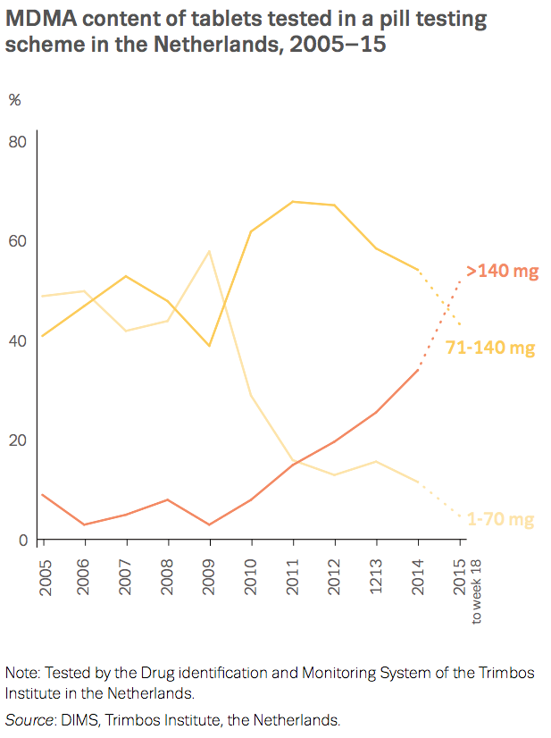
MDMA: High-dosage tablets

Slide 60
Important gaps & areas for development
Links to other crime areas
Drug market-related violence
Other drug-related crime

Slide 61
Key messages
Data sources that appear the same often have many important inconsistencies (WYSINWYG) !
A data source can have many different uses depending on how it is analysed.
Different data sources provide different pieces of the jigsaw which is the picture of the drug market.
All data sources have limitations so triangulation and cross-indicator analysis is essential.
It is increasingly important to consider overlaps between drugs and other crime areas.

Slide 62
Thank you for listening
For more information contact:
Nicola Singleton
Nicola.Singleton@emcdda.europa.eu
(351) 211 21 03 07
Teodora Groshkova
Teodora.groshkova@emcdda.europa.eu
(351) 211 21 02 45

Slide 63

European Drug Summer School 2017
  Two-week course in Lisbon with EMCDDA experts and keynote speakers
Registration
Phase 1: 17 October – 3 February (early-bird discounts)
Phase 2: 13 February – 7 April
Phase 3: 17 April – 2 June
  www.drugsummerschool.cies.iscte-iul.pt

Slide 64
acro.epdt.project@acro.pnn.police.uk

